Slide 1


Optimizing data fetching
Notes:
This lesson covers
Caching and batching data-fetch operations
Using the DataLoader library with primary keys and custom IDs
Using GraphQL’s union type and field arguments
Reading data from MongoDB
Now that we have a GraphQL service with a multimodel schema, we can look at one of GraphQL’s most famous problems, the N+1 queries problem. We ended the previous lesson with a GraphQL query that fetches data from three database tables.
Because the GraphQL runtime traverses the tree field by field and resolves each field on its own as it does, this simple GraphQL query resulted in a lot more SQL statements than necessary.

Slide 2
Caching and batching
Single resource fields
Circular dependencies in GraphQL types
Using DataLoader with custom IDs for caching
Using DataLoader with MongoDB
Table of Contents

Slide 3

Caching and batching
{
taskMainList {
content
author {
id
username
name
}
}
}
Notes:
To analyze a solution to this problem, let’s go back to the simpler query from listing 6.30.
If you remember, this query was issuing six SQL SELECT statements to the database, which is an example of the N+1 problem (N being five Task records). We’ve seen how to use database join views to make it execute only one SQL statement, but that solution is not ideal. It’s not easy to maintain or scale.
Another solution is to use the concepts of caching and batching for all the necessary SQL statements in a single GraphQL operation:
Caching-The least we can do is cache the response of any SQL statements issued and then use the cache the next time we need the exact same SQL statement. If we ask the database about user x, do not ask it again about user x; just use the previous response. Doing this in a single API request (from one consumer) is a no-brainer, but you can also use longer-term, multisession caching if you need to optimize things further. However, caching by itself is not enough. We also need to group queries asking for data from the same tables.
Batching-We can delay asking the database about a certain resource until we figure out the IDs of all the records that need to be resolved. Once these IDs are identified, we can use a single query that takes in a list of IDs and returns the list of records for them. This enables us to issue a SQL statement per table, and doing so will reduce the number of SQL statements required for the simple query in listing 7.2 to just two: one for the azdev.tasks table and one for the azdev.users table.
Manually managing these caching and batching operations would still be a lot of work. However, this is the type of work that can be abstracted to a separate library. After releasing the GraphQL.js reference implementation, the Facebook team also released a reference implementation for such a library. They named it DataLoader (az.dev/data-loader).
TIP
While the DataLoader JavaScript project originated at Facebook as another reference implementation mirroring Facebook’s own internal data-loading library, it has since moved to the GraphQL foundation and it is now maintained by the GraphQL community. It’s a stable, battle-tested project; and despite being young, it’s already part of thousands of open source projects and is downloaded millions of times each month.

Slide 4
Caching and batching
DataLoader is a generic JavaScript utility library that can be injected into your application’s data-fetching layer to manage caching and batching operations on your behalf.
To use DataLoader in the AZdev API project, we need to install it first.
$ npm install dataloader
Notes:
This npm package has a default export that we usually import as DataLoader. This default export is a JavaScript class that we can use to instantiate a DataLoader instance. The DataLoader class constructor expects a function as its argument, and that function is expected to do the data fetching. This function is known as the batch-loading function because it expects an array of key IDs and should fetch all records associated with those IDs in one batch action and then return the records as an array that has the same order as the array of input IDs.

Slide 5

Caching and batching
For example, here’s one way to create a loader responsible for loading user records.
import DataLoader from 'dataloader';
const userLoader = new DataLoader(
userIds => getUsersByIds(userIds)
);
Notes:
Once you have the logic of fetching a list of user records based on a list of ID values, you can start using the userLoader object to fetch multiple users. F

Slide 6
Caching and batching
For example, imagine that a request in your API application needs to load information about users in the following order.
const promiseA = userLoader.load(1);
const promiseB = userLoader.load(2);
// await on something async
const promiseC = userLoader.load(1);
Notes:
DataLoader takes care of batching the first two statements into a single SQL statement because they happen in the same frame of execution, which is known in Node.js as a single tick of the event loop (az.dev/event-loop).
For the third statement, Dataloader uses its memoization cache of .load() calls. User 1 has already been fetched from the database (in the previous frame of execution, but still in the same request). Fetching it again would be redundant.
This minimization of SQL statements and elimination of redundant loads relieves pressure on your data-storage services. It also creates fewer objects overall, which may relieve memory pressure on your API application as well.
WHY DATALOADER?
While you can do the batching and caching manually, DataLoader enables you to decouple the data-loading logic in your application without sacrificing the performance of the caching and batching optimizations. DataLoader instances present a consistent API over your various data sources (PostgreSQL, MongoDB, and any others). This allows you to focus on your application’s logic and safely distribute its data-fetching requirements without worrying about maintaining minimal requests to your databases and other sources of data.
Note that DataLoader uses simple single-resource batching and short-term caching. There are other GraphQL-to-database execution layers that use multiresource batching (without caching and its many problems) to achieve similar (and often better) performance improvements. However, I think the DataLoader approach is simpler, more flexible, and easier to maintain.

Slide 7
The batch-loading function
For example, if the getUsersByIds batch function is given the input array of IDs [ 2, 5, 3, 1 ], the function needs to issue one SQL statement to fetch all user records for those IDs.
Here’s one way to do that in PostgreSQL.
SELECT *
FROM azdev.users
WHERE id IN (2, 5, 3, 1);
Notes:
A batch-loading function like getUsersByIds in listing 7.4 accepts an array of IDs (or generic keys) and should return a promise object that resolves to an array of records. To be compatible with DataLoader, the resulting array must be the exact same length as the input array of IDs, and each index in the resulting array of records must correspond to the same index in the input array of IDs.
TIP
If an ORDER BY clause is not specified in a SELECT statement, the database will pick the most efficient way to satisfy the statement. The order of the returned rows will not be guaranteed.

Slide 8

The batch-loading function
For the sake of this example, let’s assume that for this SQL statement, the database returned three user records (instead of four) in the following order:
{ id: 5, name: 'Luke' }
{ id: 1, name: 'Jane' }
{ id: 2, name: 'Mary' }
Notes:
The getUsersByIds batch-loading function cannot use the result of that SQL statement as is. It needs to reorder the records and ensure that each item aligns with the original order of IDs: [ 2, 5, 3, 1 ].

Slide 9

The batch-loading function
If an ID has no corresponding record in the result, it should be represented with a null value:
[
{ id: 2, name: 'Mary' },
{ id: 5, name: 'Luke' },
null,
{ id: 1, name: 'Jane' }
]
Notes:
In lesson 6, we wrote the pgApi.userInfo function in api/src/db/pg-api.js. Let’s convert that into a batch-loading function and see what we need to do to make it DataLoader-compatible.
First, we should rename it to usersInfo now that it will be used to return an array of user records. We should also rename its argument to userIds to indicate that it expects a list of user IDs.
The sqls.usersFromIds statement is already designed to work with an array of user IDs (using the ANY construct).
We need to change the $1 value we pass to be the new userIds argument, which itself should be an array.
THE ANY COMPARISON CONSTRUCT
There are many ways to fetch multiple records from the database using an array of IDs. The easiest is to use the ANY PostgreSQL comparison construct because we can feed it an array directly (so no array manipulation is needed).

Slide 10

The batch-loading function
const pgApiWrapper = async () => {
// ·-·-·
return {
// ·-·-·
usersInfo: async (userIds) => {
const pgResp = await pgQuery(sqls.usersFromIds, { $1: userIds });
return userIds.map((userId) =>
pgResp.rows.find((row) => userId === row.id)
);
},
// ·-·-·
};
};
Notes:
Finally, we need to reorder the list of user records coming from the database to match the order in the input array of userIds. We can use a simple .map/.find combination to do that.
Here are all the changes we need to make the pgApi.usersInfo a DataLoader-compatible batch-loading function.

Slide 11
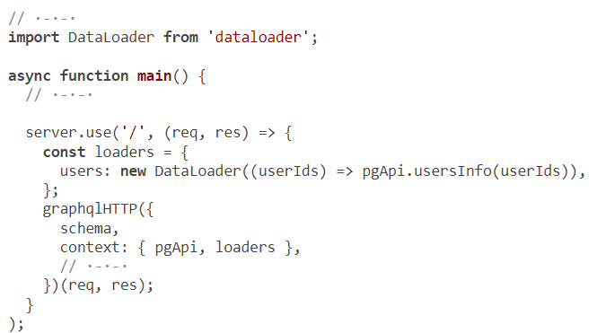
Defining and using a DataLoader instance
Notes:
DataLoader caching is not meant to be part of your application-level caching that’s shared among requests. It’s meant to be a simple memoization to avoid repeatedly loading the same data in the context of a single request in your application. To do that, you should initialize a loader object for each request in your application and use it only for that request.
Since we’re using the Express.js framework to manage requests to the AZdev API, to make the “Users loader” scoped to a single request, we can define it inside the listener function of the server.use call in api/src/server.js.
However, the code currently delegates the entire listener function argument to the graphqlHTTP higher-order function. We’ll need to change that. Here’s one way of doing so.
This change introduces a new function as the listener function for server.use, defines the users loader within this new request-scoped context, and then delegates the rest of the work back to the graphqlHTTP function. With that, we’re now able to make the new loaders object part of the GraphQL context object.
Note that I made loaders into an object that has the usersDataLoader instance as a property because we will be introducing more loaders for more database models.
Also note that graphqlHTTP is a higher-order function that returns another function. Its returned function expects the req and res arguments (coming from the Express listener function). We are basically doing the same thing as before; but now that we’ve introduced a wrapper listener function, we need to pass these req and res objects manually.
TIP
I defined the loaders object for both POST and GET requests. Ideally, in a production environment, it should be defined only for POST requests. I’ll leave that part for you to optimize.
That’s it for initializing the loaders. Each time there is a request, we create a DataLoader instance for the Users model that uses the pgApi.usersInfo batch-loading function that we have prepared. Let’s now replace the manual direct fetching of users in the codebase with this new DataLoader instance. We need to modify the two GraphQL types that previously used pgApi.userInfo. Look that up: we used it in the Task and Approach types.

Slide 12
const Task = new GraphQLObjectType({
name: 'Task',
fields: {
// ·-·-·
author: {
type: new GraphQLNonNull(User),
resolve: (source, args, { loaders }) =>
loaders.users.load(source.userId),
},
// ·-·-·
},
});
Defining and using a DataLoader instance
Notes:
Here’s how to change both of these places to use the new usersDataLoader instance. First, here is the Task type.

Slide 13

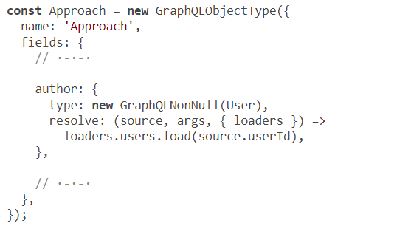
here is the Approach type.
Notes:
The changes to these types are identical. We use the new loaders object in the resolver’s context object (instead of the previous pgApi object) and then use a .load call on the usersDataLoader instance.
DataLoader takes care of the rest! When multiple .load calls are made in the same execution context while the GraphQL query is being resolved, DataLoader batches the calls. It prepares an array from all the loaded IDs and executes the batch-loading function just once. It then uses the response for that single call to satisfy all user data requirements that were made in the query.

Slide 14
Defining and using a DataLoader instance
If we try the same GraphQL query now while tailing the logs of PostgreSQL, we will see something like the following excerpt from my PostgreSQL logs:
LOG: statement: SELECT ... FROM azdev.tasks WHERE ...
LOG: execute <unnamed>: SELECT ... FROM azdev.users WHERE id = ANY ($1)
DETAIL: parameters: $1 = '{1}'
Notes:
Note that the parameter value is {1}, which represents an array in PostgreSQL. More important, note that only one SQL statement was issued for the users table (instead of five, as previously).
We added a lot of value with just a few lines of code. But to appreciate it more, let’s exclusively load the other ID-based data fetching through DataLoader instances. Remember the GraphQL query that made 17 SQL statements at the end of lesson 6? Let’s see how many SQL statements it will make after converting all data-fetching logic to go through DataLoader instances.

Slide 15
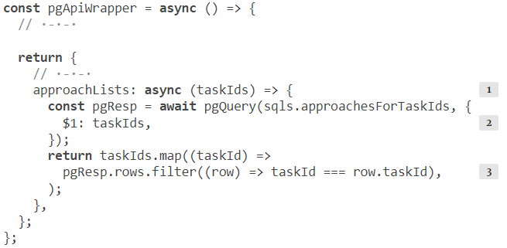
The loader for the approachList field
Notes:
The other ID-based fetching we have done so far is in the pgApi.approachList function in api/src/db/pg-api.js. This function is a bit different than the pgApi .usersInfo function as it takes a taskId and returns an array of Approach records. This means when we switch it to work with an array of keys instead of a single value, it will take an array of taskIds, and it should return an array of arrays (each array representing the list of Approaches for one Task).
DataLoader, in this case, will be concerned about the order of the top-level array. The order of the items in the inner-level arrays is an application-level concern.
sqls.approachesForTaskIds accepts an array of Task IDs, but it will return a single list of all the Approach records under all the input Task IDs. We’ll need to split this list and group Approach records by Task IDs while keeping the order of the top-level array matching the order of the input array.
We can use a .map/.filter combination to do that. Here are all the changes I made to this function.

Slide 16
The loader for the approachList field
const loaders = {
users: new DataLoader((userIds) => pgApi.usersInfo(userIds)),
approachLists: new DataLoader((taskIds) =>
pgApi.approachLists(taskIds),
),
};
Notes:
The pgApi.approachLists batch-loading function is now compatible with DataLoader. To use it, we instantiate a new loader instance in api/src/server.js.
Then we use this new instance in the GraphQL types that previously used a direct database fetch to list Approaches.

Slide 17

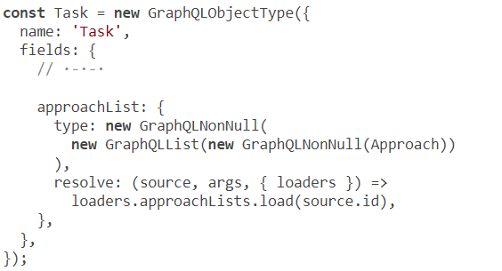
The loader for the approachList field
Notes:
The only type that did that is the Task type.

Slide 18
The loader for the approachList field
LOG: statement: SELECT ... FROM azdev.tasks WHERE ...;
LOG: execute <unnamed>: SELECT ... FROM azdev.users WHERE id = ANY ($1)
DETAIL: parameters: $1 = '{1}'
LOG: execute <unnamed>: SELECT ... FROM azdev.approaches WHERE task_id = ANY
➥ ($1) ...
DETAIL: parameters: $1 = '{1,2,3,4,6}'
Notes:
test the same query we tested at the end of lesson 6 (listing 6.24) while tailing the PostgreSQL logs. You should see something like this excerpt from my PostgreSQL logs:
The key thing to notice here is that we’re using a single SQL query to fetch Approaches for all Tasks. This same query will be used whether we have 100 or 1,000 Tasks.
With the new DataLoader instances in place, the query that used 17 SQL statements before is now using only 3 statements (one statement per database table). We did not need to do any join statements or field renaming. This is a win!

Slide 19
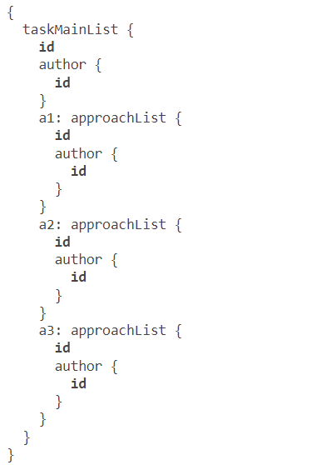
The loader for the approachList field
Notes:
Win also contributes to making the server more resilient to denial-of-service attacks using intentionally complicated queries: for example, if we used GraphQL’s alias concept to ask for Approach data multiple times, as follows.
The DataLoader instances would take care of not going to the database multiple times per alias. This intentionally complicated query would still only execute three statements over the wire. We should certainly put more protection layers between public queries and the backend schema, but it’s good to know that if something slipped through the cracks, we have a level of optimization to fall back on.
CURRENT CODE
Use git checkout to reset your local repo to the current progress in the code.
Note that we did not need to optimize the sqls.tasksLatest statement because it does not depend on IDs (so no batching is needed). However, we can still use DataLoader to take advantage of the caching of any query asking for the taskMainList field. We’ll do that soon, but first let’s implement the task field under an Approach object and learn about circular dependencies with GraphQL types.

Slide 20
Caching and batching
Single resource fields
Circular dependencies in GraphQL types
Using DataLoader with custom IDs for caching
Using DataLoader with MongoDB
Table of Contents

Slide 21

Single resource fields
In our schema plan, the taskInfo root query root field is supposed to fetch the information for a single Task record identified by an ID that the API consumer can send as a field argument.
type Query {
taskInfo(id: ID!): Task
// ·-·-·
}

Slide 22
Query that we can use to work through this field.
query taskInfoTest {
taskInfo(id: 3) {
id
content
author {
id
}
approachList {
content
}
}
}
Single resource fields
Notes:
Note that this field has to support the nested author and approachList information. But guess what? We don’t need to do anything new. We have already implemented these relationships under taskMainList. The taskInfo field uses the same output type (Task).

Slide 23
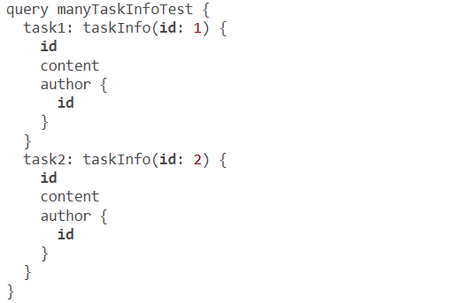
Single resource fields
Notes:
You might be tempted to think that since this taskInfo field works with a single record, there is no need to use DataLoader for it. However, using DataLoader is preferable for many reasons. For one thing, having all database fetch requests go through DataLoader is simply a good code abstraction practice, but there is still performance value for composite queries. For example, take a look at this query.
If we don’t use a DataLoader instance for the taskInfo field, this query will ask the database about two Task records using two SQL statements. With a DataLoader instance, these two statements are batched into one.

Slide 24
Single resource fields
import { GraphQLSchema, printSchema } from 'graphql';
import QueryType from './queries';
export const schema = new GraphQLSchema({
query: QueryType,
});
console.log(printSchema(schema));
Notes:
Before we implement the taskInfo field, let’s do a little refactoring. The api/src/schema/index.js file is currently doing two things that are logically separate: it defines the main Query type and uses it to create a schema. Let’s split these two tasks into two files instead of one.

Slide 25
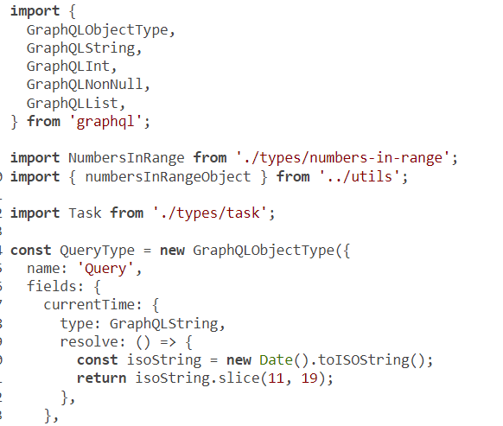
Single resource fields
Notes:
Move everything else that was in the file to api/src/schema/queries.js, and export the main QueryType from that file.

Slide 26
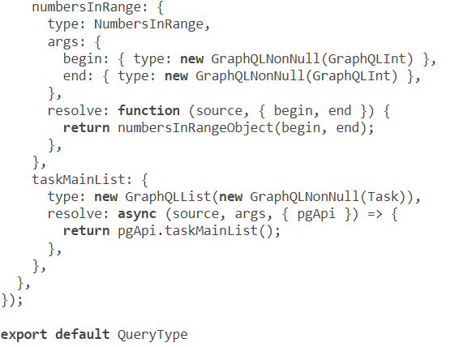
Continued code
Notes:
TIP
Note that I made the refactoring changes in a separate Git commit. This is a good practice to keep the history of changes in a Git repo clean and easy to understand.

Slide 27
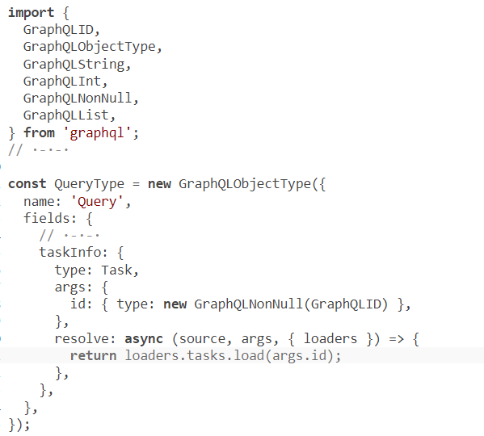
Single resource fields
Notes:
Let’s make this change with a top-down approach this time (so far, we’ve been using a bottom-up approach). We’ll first define the taskInfo root query (in the new api/src/schema/queries.js file). Note that-for the first time so far-we’re going to use a field argument (the id argument for taskInfo). In the definition of the taskInfo field, we have to include the type of that id argument. We can use the GraphQLID type for it.
The loaders.tasks function does not exist yet. I often start planning for a change in the codebase just like this.

Slide 28
Single resource fields
I find it helpful to think about the new objects and functions I need and use them before I write them.
This approach helps me come up with better, more practical designs. The new loader function goes in api/src/server.js.
const loaders = {
// ·-·-·
tasks: new DataLoader((taskIds) => pgApi.tasksInfo(taskIds)),
};

Slide 29
Single resource fields
Following the top-down analysis, we now need to define the pgApi.tasksInfo function.
I have prepared a sqls.tasksFromIds statement for it in api/src/db/sqls.js.
// $1: taskIds
// $2: userId (can be null)
tasksFromIds: `
SELECT ...
FROM azdev.tasks
WHERE id = ANY ($1)
AND (is_private = FALSE OR user_id = $2)
`,
Notes:
Something new and important is introduced in this statement. It takes two variables: one is the IDs of tasks to be loaded, and the other is a userId argument. The query will then make sure the looked-up Task is either public or owned by the user identified by the userId value. Without that condition, private Tasks can be looked up using the taskInfo field (which will use this SQL statement).
This SQL statement can be used without a userId value (which is what we need to do first); for that case, it will only fetch information about public Task records.

Slide 30
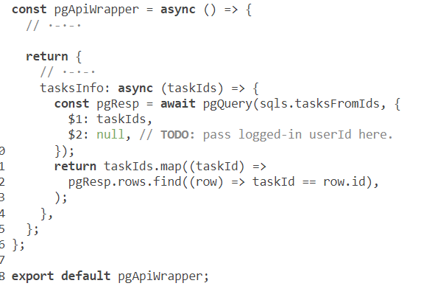
Single resource fields
Notes:
Here’s the pgApi DataLoader-compatible function to execute the SQL statement.

Slide 31
Caching and batching
Single resource fields
Circular dependencies in GraphQL types
Using DataLoader with custom IDs for caching
Using DataLoader with MongoDB
Table of Contents

Slide 32
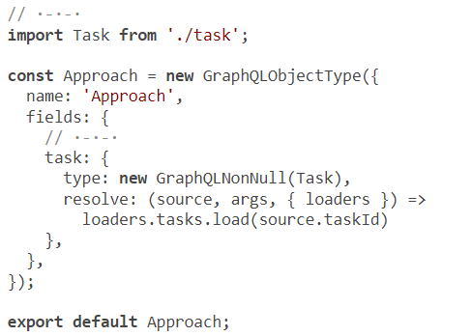
Circular dependencies in GraphQL types
Notes:
We designed the Approach type to have a task field so that we can display the parent Task information when a search result item is an Approach record. To implement this relation, we can reuse the loaders and pgApi function we wrote for the taskInfo root field.
However, this relation is the inverse of the Task -> Approach relation we implemented for the approachList field. This means it will introduce a circular dependency in the graph: Task -> Approach -> Task -> Approach -> ...
To see this problem in action, let’s try to implement the new relation. The only change we need to make is the Approach type.
Since the Approach type now needs to use the Task type, and since that Task type already uses the Approach type, the Approach type will hit the circular dependency problem. Check it out: here are the necessary changes.
The server logs will report this problem:
ReferenceError: Task is not defined

Slide 33
Circular dependencies in GraphQL types
const Approach = new GraphQLObjectType({
name: 'Approach',
fields: () => ({
// ·-·-·
task: {
type: new GraphQLNonNull(Task),
resolve: (source, args, { pgApi }) =>
pgApi.tasks.load(source.taskId),
},
}),
});
Notes:
Luckily, there is a simple solution. Instead of using types directly under the fields property, that property can be a function whose return value is the object representing the fields. GraphQL.js supports this out of the box, and it’s handy for situations like these.
Changing the fields configuration property to be a function delays this dependency and uses it dynamically instead of statically. That function is basically executed after Node.js loads all modules. This function is often referred to as a thunk, which is a fancy name for a function that is used to delay a calculation until results are needed (among a few other applications).
The ReferenceError should be gone now. Verify that, and test the task field under the approachList field.
It is a good practice to always use the function signature for the fields configuration property instead of the object form. Go ahead and make that change, and retest the queries we already finished.

Slide 34
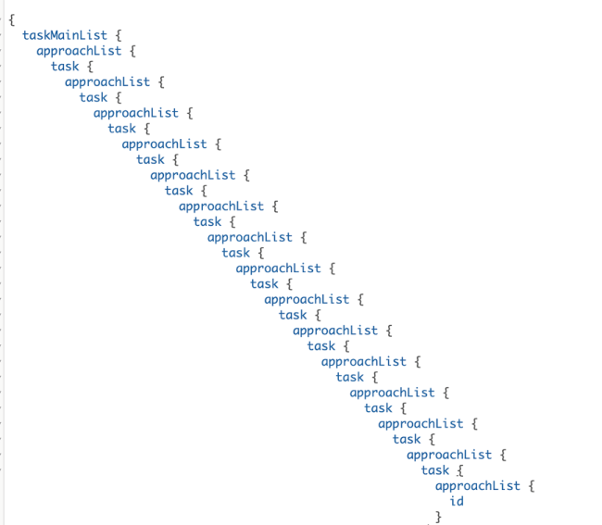
Deeply nested field attacks
Notes:
When you implement two-way relations, you should think of a way to prevent the deeply nested field attacks discussed in lesson 1. For example, the new Approach -> Task relation will open the door for a query like this
You can protect your API server against this type of attack in many ways. The simplest solution is just to count the nesting levels and block the query after a certain threshold. The fourth argument of each resolver has a path property that can be used for that purpose if you want to selectively do this check in certain fields (like task on the Approach type). However, a better way here would be to do this validation per operation rather than per resolver.
You can also design your schema such that nested attacks are not even possible. For example, we can come up with a different type for a “search-result-approach-object” and define the task field only on that type rather than the main Approach type. Similarly, the approachList field can be made available only under the taskInfo root field and not under the taskMainList field (where it is actually not needed in the UI).
TIP
The deeply nested field attack is just one example of many ways an API server can be attacked with intentionally complicated operations. To protect your server from all of them, you can analyze each operation to be executed, estimate how much time and data it will use, and block operations beyond certain thresholds. There are libraries out there to help you do that. You can also just let all queries run but implement a timeout to cancel operations that take a long time. Or, you can implement a timeout based on custom cost factors you define on specific operations and block an operation if its total cost goes beyond a certain threshold.

Slide 35
Caching and batching
Single resource fields
Circular dependencies in GraphQL types
Using DataLoader with custom IDs for caching
Using DataLoader with MongoDB
Table of Contents

Slide 36
{
a1: taskMainList {
id
}
a2: taskMainList {
id
}
a3: taskMainList {
id
}
a4: taskMainList {
id
}
}
Using DataLoader with custom IDs for caching
Notes:
Although a DataLoader batch-loading function is often associated with a list of input IDs, you don’t need actual IDs coming from primary fields in the database. You can come up with your own ID-to-result association and use DataLoader with the custom map you designed. This is usually helpful when you are using the caching aspect of DataLoader. For example, you can come up with SQL statements and give each statement a unique label. That label becomes one of the IDs you can use with a DataLoader instance.
Many examples in the GraphQL schema we designed could benefit from that approach. One of them is the taskMainList field.
The taskMainList field
Let’s test how many SQL statements the following GraphQL query will currently issue. Can you guess?
Since we have not used DataLoader for taskMainList, this GraphQL query will issue the same SELECT statement four times.

Slide 37
The taskMainList field
Here’s the related excerpt from my PostgreSQL logs:
LOG: statement: SELECT ... FROM azdev.tasks WHERE ....;
LOG: statement: SELECT ... FROM azdev.tasks WHERE ....;
LOG: statement: SELECT ... FROM azdev.tasks WHERE ....;
LOG: statement: SELECT ... FROM azdev.tasks WHERE ....;
Notes:
We can use DataLoader to cache the data response it gets the first time it loads this list and then not go back to the database for the same request. However, DataLoader is wired to fetch a value for a key. You can think of the “value” here as the list of the latest Task records, but there are no keys in this case. To make this database statement work with DataLoader, we need to come up with a custom key for this SELECT statement. A key here is just any unique label for it. I’ll use the label latest for this one.

Slide 38
The taskMainList field
const QueryType = new GraphQLObjectType({
name: 'Query',
fields: () => ({
// ·-·-·
taskMainList: {
type: new GraphQLList(new GraphQLNonNull(Task)),
resolve: async (source, args, { loaders }) => {
return loaders.tasksByTypes.load('latest');
},
},
}),
});
Notes:
Let’s do this change with a top-down approach. The type that needs to be resolved with the latest Tasks is the root Query type. Instead of issuing pgApi.taskMainList(), let’s assume we have a tasksByTypes loader that can fetch any list of Task records by a particular type, and let’s fetch the latest type.

Slide 39
The taskMainList field
const loaders = {
// ·-·-·
tasksByTypes: new DataLoader((types) =>
pgApi.tasksByTypes(types),
),
};
graphqlHTTP({
schema,
context: { loaders },
graphiql: true,
// ·-·-·
})(req, res);
Notes:
Note that I am using a top-down approach here as well. Let’s now write the tasksByTypes loader. We’ll need to add it to the listener function (in api/src/server.js).
Again, I’ve used a tasksByTypes property that does not exist on pgApi yet. This is my plan for the new batch-loading function. We’ll write that next.

Slide 40
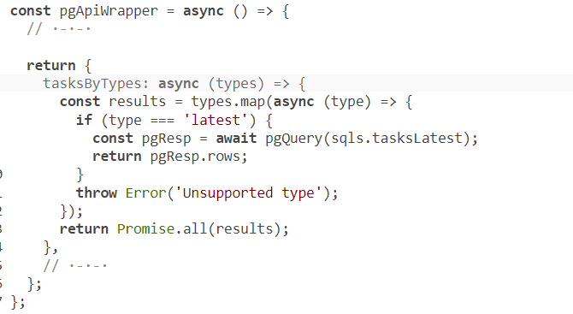
The taskMainList field
Notes:
The new pgApi.tasksByTypes batch-loading function is special in this case. It currently only supports loading the latest type, but we still have to write it in a way that makes it accept an array of types and return an array of results associated with these types.
Note that the SQL query is invoked within the .map call, making the map callback function return a pending promise, which makes the results object an array of pending promises. That’s why I wrap the returned result with a Promise.all call. Depending on what other types we end up adding (or not adding), this particular way of fetching within a map call can be optimized. It’s okay as is for now because we’re really just faking the batching nature of this list.
That’s it. No matter how many aliases you add to fetch the taskMainList root field, DataLoader will only ask the database about that list once. Verify that.
With DataLoader in the stack, we can now continue implementing other fields and either use existing loaders or define new ones as needed.

Slide 41
The search field
The search field takes an argument-the search term-and returns a list of matching records from both the Task and Approach models through the interface type they implement: SearchResultItem.
type Query {
# ...
search(term: String!): [SearchResultItem!]
}
Notes:
The search term, in this case, is the unique key that can be used with a DataLoader batch-loading function.

Slide 42
The search field
interface SearchResultItem {
id: ID!
content: String!
}
type Task implements SearchResultItem {
# ...
}
type Approach implements SearchResultItem {
# ...
}
Notes:
The search feature has a new concept that we’re going to implement for the first time: the GraphQL interface type. Here are the parts of the schema related to it.
For each record in the search results, the new interface type needs a way to determine what type it is. It needs to tell the API consumer that a search result is a Task object or an Approach object. We can do that using the resolveType configuration property, which is a function whose argument is the object that implements the Search-ResultItem type; it needs to return which GraphQL type represents that object. Let’s design the search results objects to have a type property that holds a task or approach string value. We can use that to implement the resolveType function logic.

Slide 43
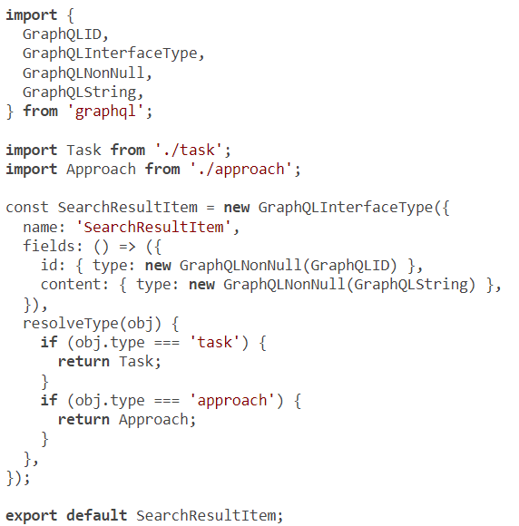
The search field
Notes:
Here’s one implementation of the SearchResultItem type that’s based on this plan. Put this in api/src/schema/types/search-result-item.js.
We can now use this new type to define the root search field. We also need to define the arguments this field expects. We designed it to expect a term value, which is a string. To resolve the search field, let’s assume that we have a loader named searchResults whose key is the search term.

Slide 44
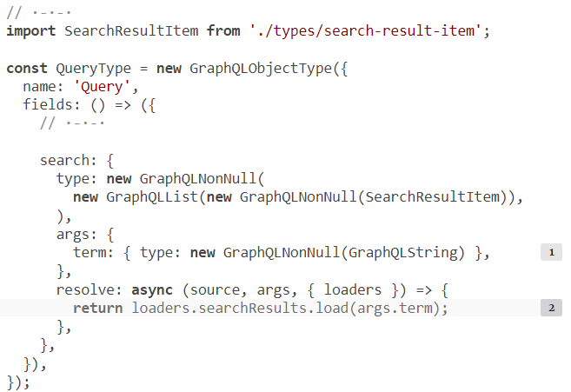
The search field
Notes:
one possible implementation of the field.

Slide 45

The search field
// ·-·-·
import SearchResultItem from './search-result-item';
const Task = new GraphQLObjectType({
name: 'Task',
interfaces: () => [SearchResultItem],
fields: () => ({
// ·-·-·
}),
});
Notes:
Now, to make the Task and Approach types implement this new interface type, we used the interfaces property of the GraphQLObjectType configuration object. The value of this property is an array of all the interface types an object type implements.

Slide 46
The search field
// ·-·-·
import SearchResultItem from './search-result-item';
const Task = new GraphQLObjectType({
name: 'Task',
interfaces: () => [SearchResultItem],
fields: () => ({
// ·-·-·
}),
});
Notes:
Note that I wrapped the interfaces array as a thunk just as we are now doing for the fields property.
Following the top-down analysis, we now need to define a DataLoader instance named searchResults. Let me pause here and ask this question: do we really need a caching/batching loader for a search query?
Probably not. It’s unlikely an API consumer will do multiple searches in one query. And unless they are intentionally trying to overload the API service, it’s unlikely they will search for the same term many times!
However, as we’ve seen in taskMainList, using a loader provides some protection against bad queries (whether they were malicious or not). Imagine a UI application with a bug that causes a search query to repeat 100 times in a GraphQL request. You don’t want your API server to issue 100 full-text-search SQL statements to the database in that case.
Another reason to use a loader for this case is for consistency. DataLoader is now an abstraction layer in our stack, and all database communication should happen through it. Mixing some direct database communication here would be a code smell.
The searchResults batch-loading function takes a list of search query terms, and it should do a full-text-search operation for each.

Slide 47
The search field
async function main() {
// ·-·-·
server.use('/', (req, res) => {
const loaders = {
// ·-·-·
searchResults: new DataLoader((searchTerms) =>
pgApi.searchResults(searchTerms),
),
};
// ·-·-·
});
// ·-·-·
};
Notes:
Let’s assume that the pgApi module has a searchResults method to do the SQL communication. Here’s what I came up with for the loader definition.
The final piece of this puzzle is the pgApi.searchResults method and the full-text-search logic it executes.

Slide 48
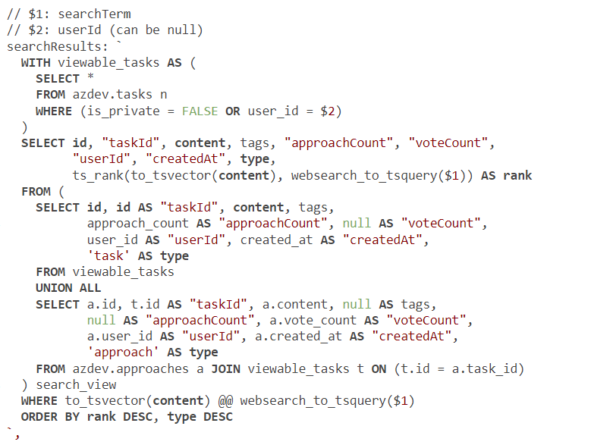
The search field
Notes:
Luckily, PostgreSQL has built-in support for full-text search. I prepared a single SQL statement that retrieves search results from both the azdev.tasks and azdev.approaches tables; check it out at sqls.searchResults.
This SQL statement uses a few cool PostgreSQL tricks. For example, it uses an inline view (viewable_tasks) to make sure the operation only works on viewable Task records, which are either public or owned by a userId value. The userId value can be null, in which case the statement will only work for public Task records.
The statement uses a UNION ALL operator to combine result sets from multiple database tables into a single set. It then uses this combined set as the source for the full-text search, which it performs using the to_tsvector, websearch_to_tsquery, and ts_rank PostgreSQL functions. This is just one set of many functions and operators that can be used to perform and optimize this search, but those are beyond the scope of this course. You can read more about PostgreSQL full-text-search capabilities at az.dev/pg-fts.

Slide 49
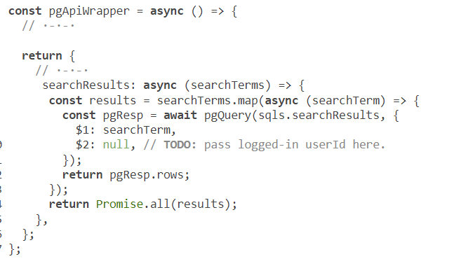
The search field
Notes:
how we can use SQL statement in the pgApi module.
Note that this function uses the same “promise-map” method we used for tasksByTypes to be DataLoader compatible. Also note that I passed the $2 value as null for now. Once we enable API consumers to log in, we need to figure out how to make the current userId value available for this function. We’ll do that in the next lesson.

Slide 50
{
search(term: "git OR sum") {
content
... on Task {
approachCount
}
... on Approach {
task {
id
content
}
}
}
}
The search field
Notes:
We can test now! Here’s an example of how to query the new search field in GraphQL.

Slide 51
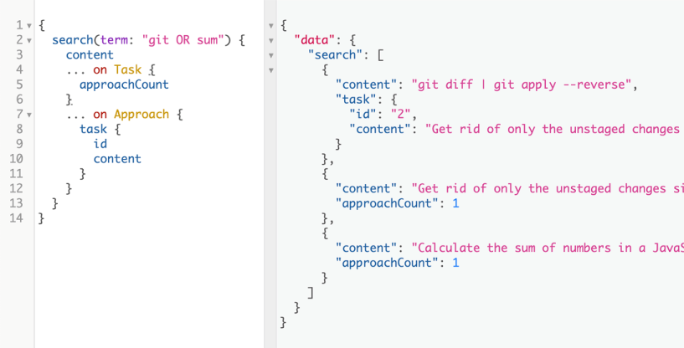
The search field
Notes:
Search should return three records from the sample data: two Task records and one Approach record
Note the power of the PostgreSQL text-search capabilities. The example uses OR, and the search results are ranked based on relevance. Try a few other search terms, and explore the many other features we enabled.
TIP
If an interface type is implemented by many types, the resolveType property can become difficult to maintain. It’s not ideal that you need to edit it every time you add another type that implements your interface. GraphQL.js supports another method to determine the type of the implementing object. You can define an isTypeOf function on every object type that implements an interface, and GraphQL.js will pick the first object type whose isTypeOf returns true. If you define isTypeOf on all objects that implement an interface, you won’t need the resolveType property.
Let’s now implement the detailList field under an Approach record. I’ve delayed implementing this one because of its complexity and because we really should do it through DataLoader. I think we’re ready for it.

Slide 52
Caching and batching
Single resource fields
Circular dependencies in GraphQL types
Using DataLoader with custom IDs for caching
Using DataLoader with MongoDB
Table of Contents

Slide 53
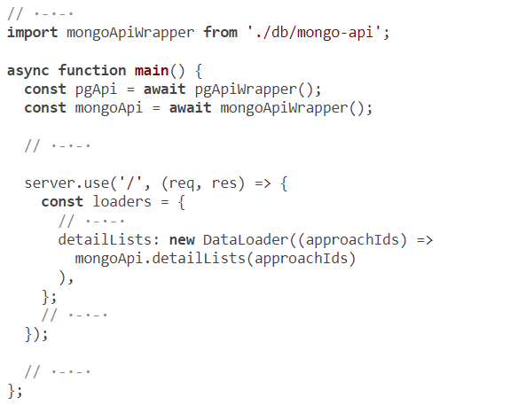
Using DataLoader with MongoDB
Notes:
Since we’ve decided to store the dynamic Details of an Approach record in MongoDB, we need to make a DataLoader instance that fetches data from there. This is the first time we will be reading data from MongoDB, so we need to create an API module for MongoDB, instantiate it on the main server, and use it to define a DataLoader instance.
Let’s do this one with a top-down approach as well. Similar to how we named objects for PostgreSQL and where we stored its modules, let’s come up with a mongoApi module and assume that it has a batch-loading function named detailLists to load a list of Detail objects given a list of Approach IDs.
Here are the changes I came up with for api/src/server.js (mirroring what’s there for PostgreSQL).
The new mongoApi module will host all the interactions with MongoDB.

Slide 54
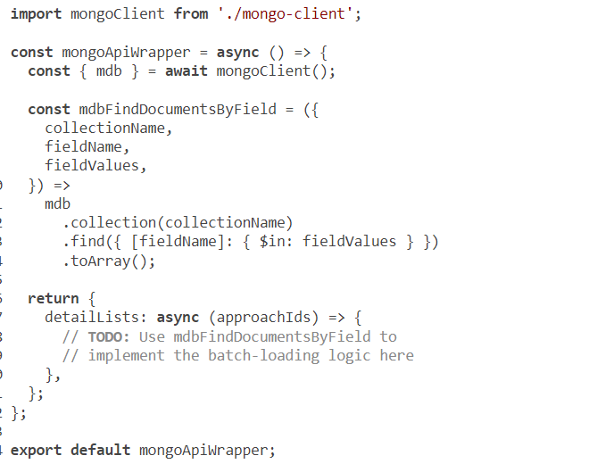

Using DataLoader with MongoDB
Notes:
the implementation I came up with for it (also mirroring what we have so far for api/src/ db/pg-api.js). Put this in api/src/db/mongo-api.
Note that I placed the current mongo-client driver’s logic to find a list of documents in a MongoDB collection into its own function named mdbFindDocumentsByField (just as I did for pgQuery). Eventually, there will be more functions of this nature, and they can be abstracted, maintained, and tested separately from the application-level logic that’s going to use them. In fact, I’m already thinking these functions should be moved to the client files, but I’ll keep them next to their usage for simplicity.
TIP
The abstraction I did for mdbFindDocumentsByField is a bit more detailed than what I did for pgQuery because the mongo driver API uses JavaScript objects (versus SQL text statements in the pg driver). The level of abstraction is a matter of preference, but what I tried to achieve here is to keep everything related to the mongo driver separate from the application-level logic (to make the code DataLoader compatible, for example). An argument can be made that this is a premature abstraction, but I have been down this road many times, and I’ve found these abstractions very helpful as the project grows.
Because the mongoApi.detailLists function is used as the batch-loading function for a DataLoader instance, it needs to maintain the size and order of the input array of approachIds. Let’s figure out what we need here, one piece at a time.

Slide 55
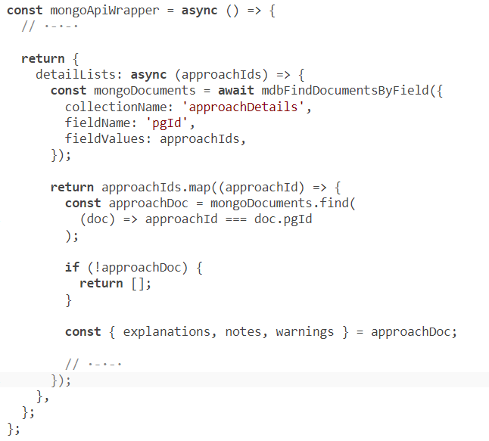
Using DataLoader with MongoDB
Notes:
First, remember that the approachIds value is coming from PostgreSQL, which means we will need to filter the response we get out of MongoDB for the approachDetails collection using the pgId field on a document to find each document associated with each Approach. If there is no match in MongoDB, that means the Approach record has no Detail records.
Using the same .map/.find trick we did in pgApi.usersInfo, here’s the skeleton of what we need in mongoApi.detailLists.

Slide 56
Using DataLoader with MongoDB
Once the ID-to-document map is finished, each approachDetails document in MongoDB is an object whose properties represent the three content categories that we designed for the ApproachDetail ENUM type.
enum ApproachDetailCategory {
NOTE
EXPLANATION
WARNING
}

Slide 57
Using DataLoader with MongoDB
Each of these properties holds an array of text values. However, remember that we designed the ApproachDetail type to have a category field and a content field.
type ApproachDetail {
category: ApproachDetailCategory!
content: String!
}
Notes:
This means we need a bit of logic to take an object:
{
explanations: [explanationsValue1, ·-·-·],
notes: [notesValue1, ·-·-·],
warnings: [warningsValue1, ·-·-·],
}

Slide 58
We convert the object to the following:
[
{
content: explanationsValue1,
category: "EXPLANATION"
},
{
content: notesValue1,
category: "NOTE"
},
{
content: warningsValue1,
category: "WARNING"
},
·-·-·
]
Using DataLoader with MongoDB
Notes:
Furthermore, the content categories are optional in an approachDetail document. One category might have 10 values while another category might not exist

Slide 59
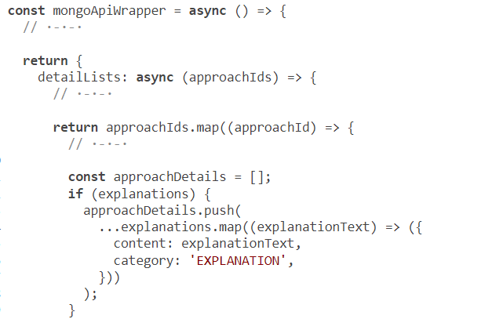
Using DataLoader with MongoDB
Notes:
Considering all these points, here’s one way to do the necessary conversion for the schema.

Slide 60
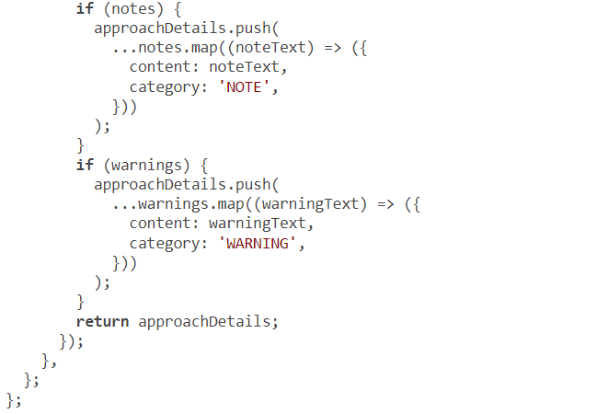
Using DataLoader with MongoDB
Notes:
We start with an empty array of objects (approachDetails). Then, for each array values property on an approachDetail document, if that array value exists, we push into the approachDetails array all the items in that array value after mapping them to the { content: '·-·-·', category: '·-·-·' } structure.
TIP
There is certainly a chance to do the three if statements in listing 7.44 dynamically with one loop and allow for future values in an Approach Detail category. I’ll leave that for you as an exercise.

Slide 61
Using DataLoader with MongoDB
import { GraphQLEnumType } from 'graphql';
const ApproachDetailCategory = new GraphQLEnumType({
name: 'ApproachDetailCategory',
values: {
NOTE: {},
EXPLANATION: {},
WARNING: {},
},
});
export default ApproachDetailCategory;
Notes:
Next, we need to define two new types in this GraphQL schema: ApproachDetail and ApproachDetailCategory. Let’s start with the latter. It’s an ENUM with three fixed values. To define an ENUM type, the GraphQL.js API provides a GraphQLEnumType constructor that takes a configuration object representing the ENUM values. Here’s what I did to define the ApproachDetailCategory type. Put this in a new file at api/src/schema/types/approach-detail-category.js.

Slide 62
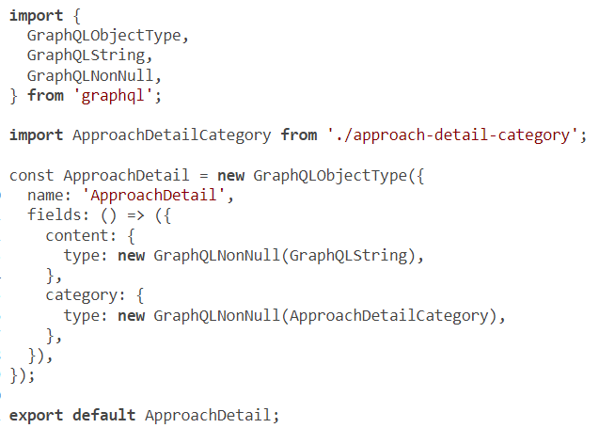
Using DataLoader with MongoDB
Notes:
Now we can define the ApproachDetail type, which uses the ApproachDetailCategory type. The ApproachDetail type is a simple instance of GraphQLObjectType. Create a new file for it at api/src/schema/types/approach-detail.js.

Slide 63
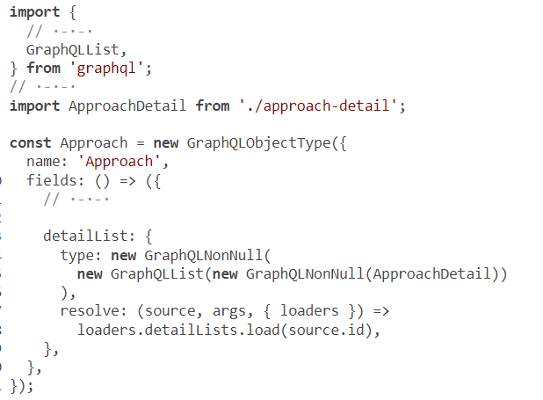
Using DataLoader with MongoDB
Notes:
Finally, we need to define the detailList field itself on the Approach type. This is where we use the new DataLoader instance, and it’s exactly the same as we did for the previous types. Hopefully this is getting easier now!

Slide 64
You can test this new feature using the following query (see next slide figure).
{
taskMainList {
content
approachList {
content
detailList {
content
category
}
}
}
}
Using DataLoader with MongoDB

Slide 65
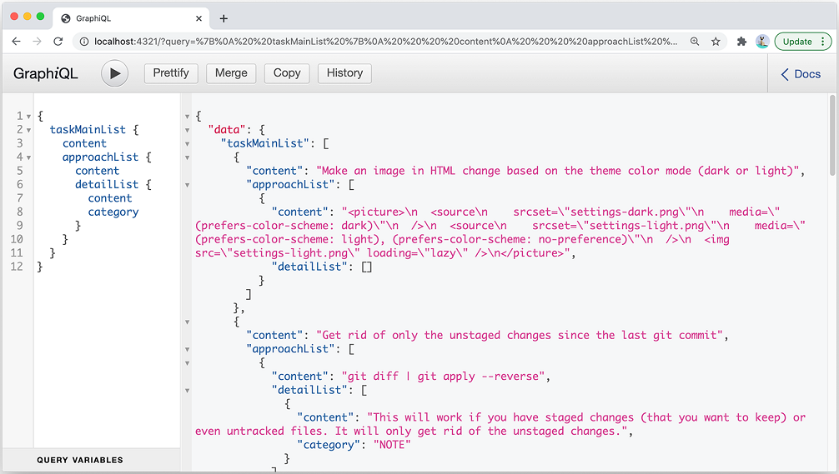
Using DataLoader with MongoDB
Notes:
For each of the five public Tasks in our sample data, this query fetches all Approaches from PostgreSQL and then fetches all Details on every Approach from MongoDB. Guess how many times it reaches out to MongoDB?
One time.
Thanks to the DataLoader instance, all of the MongoDB operations are batched into a single one.
The only root query field remaining is the me field, but to properly test it we need a valid authentication token. Let’s first implement the mutations we designed for the schema. Then, once we can issue the mutation to get a valid authToken value, we will implement the me field and do the TODOs we left in the code that require passing the ID for the current user (as identified by an authToken).

Slide 66
Summary
To optimize data-fetching operations in a generic, scalable way, you can use the concepts of caching and batching.
You can cache SQL responses based on unique values like IDs or any other custom unique values you design in your API service.
Notes:
You can also delay asking the database about a specific resource until you figure out all the unique IDs of all the records needed from that resource and then send a single request to the database to include all the records based on all the IDs.
DataLoader is a generic JavaScript library that can be used as part of your application’s data-fetching layer to provide a simplified, consistent API over various data sources and abstract the use of batching and caching. This enables you to focus on your application’s logic and safely distribute its data-fetching requirements without worrying about maintaining minimal requests to your databases and other sources of data.
DataLoader instances are meant to be scoped for a single request. They can be used for both ID-based SQL statements and more complex statements like fetching lists or even full-text-search requests.
If you use DataLoader in your stack, it’s a good practice to do all database communications through it. Your GraphQL resolvers will then delegate the task of resolving the data to the DataLoader instances. This makes the code cleaner and more maintainable.

Slide 67

"Complete Lab"

